Slide 1
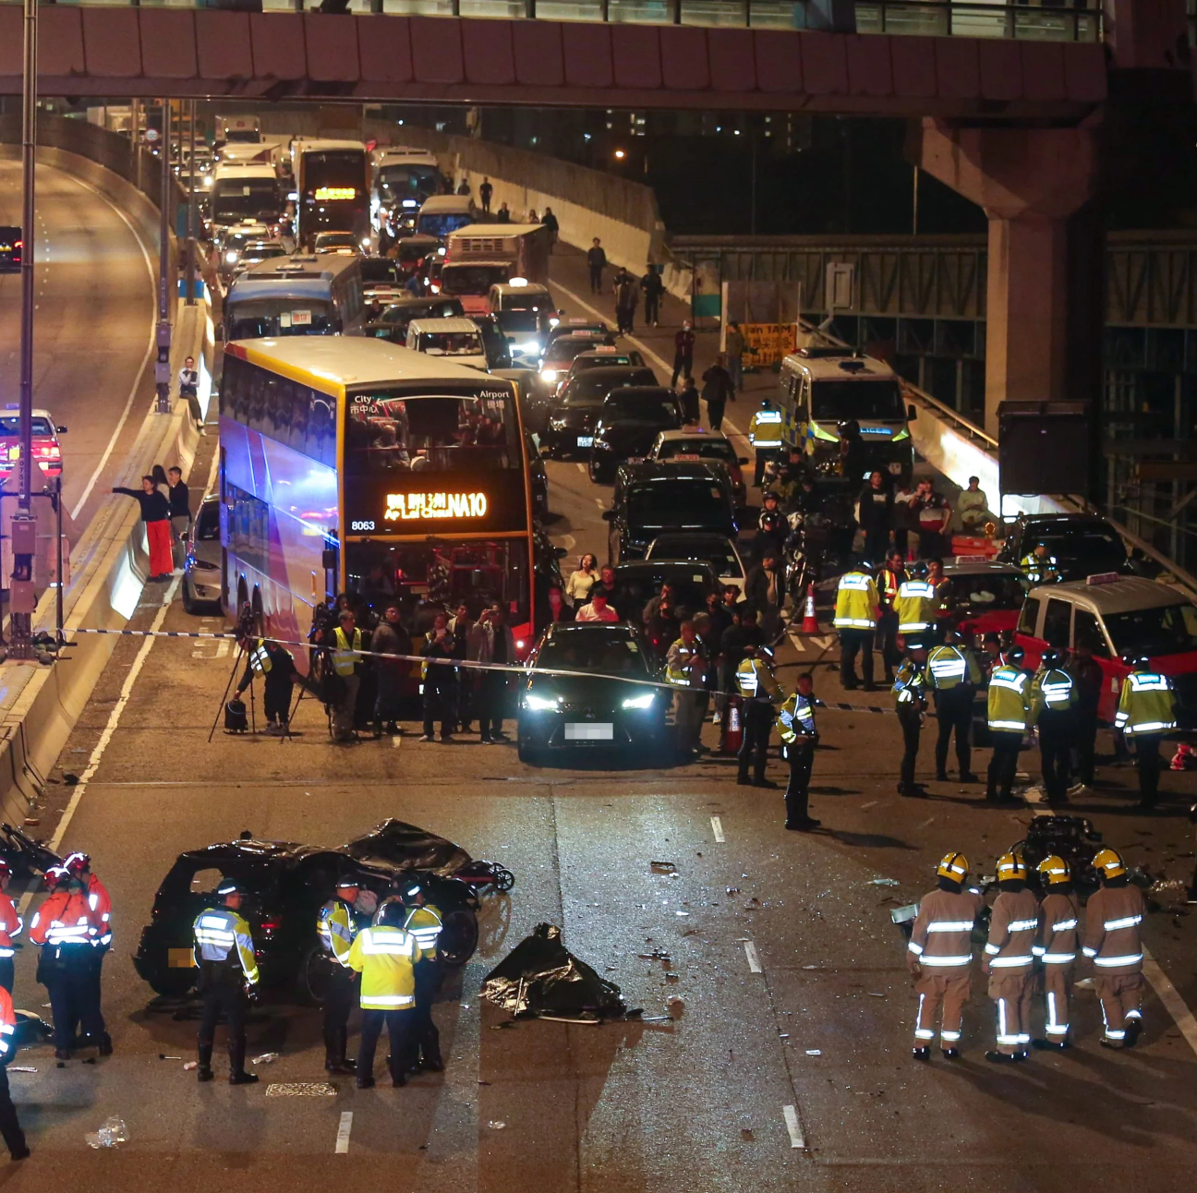
Predicting severity of accidents based on traffic conditions
YAU CHUN WING (1155251820)
KWOK KAI YIN (1155251560)
HO KA HO (1155246984)
NG CHING WAI (1155253020)
TANG SIU WAN (1155143082)
CHAN CHI CHIU (1155253025)

Slide 2
Project Overview & Objective
Predictive Modeling: Develop robust models to classify accident severity levels using traffic environment factors
Determinant Analysis: Identify and quantify the most influential variables contributing to accident severity
Model Comparison: Evaluate the trade-offs between interpretability (statistical models) and predictive accuracy
Policy Insights: Translate findings into actionable recommendations for traffic safety policies, road design improvements, and driver education programs

Slide 3
Source: Hong Kong Transport Department
Datasets:
Road Traffic Accident Database (publicly available, downloaded from Transport Department website)
Supplementary information obtained via formal requests under the Code on Access to Information
Scope: Analysis limited to 2024 accident records
Data
Collection

Slide 4
Missing Values: Checked for incomplete records
Data Consistency: Standardized variable formats (date/time, grouped categories)
Feature Preparation: Normalized calculated variables for machine learning models
Dummy variables: Create dummy variables for different types of vehicles
Data
Collection

Slide 5
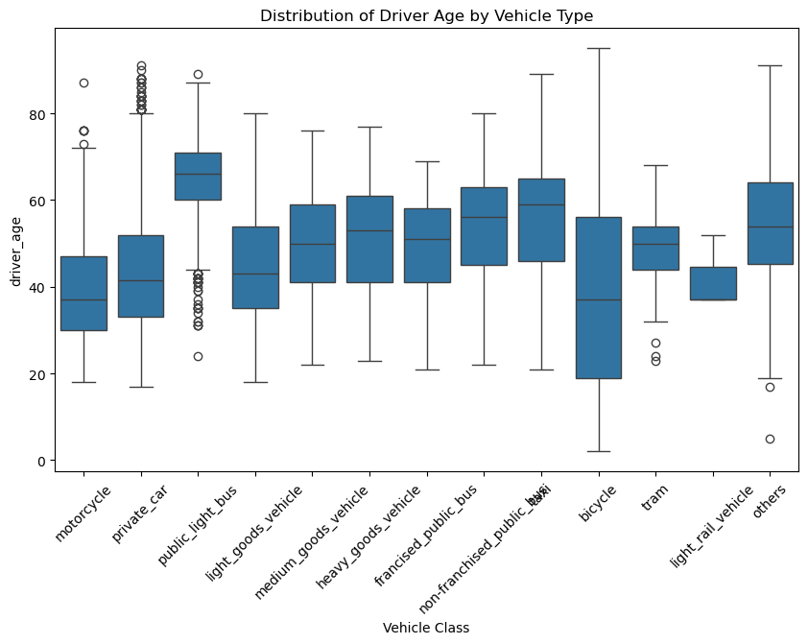
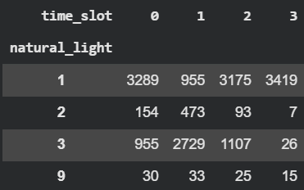
Data
Collection
Missing driver age and year of manufacture of vehicles: median age of each vehicle type
Rain and weather: Based on rain and weather conditions on same date and time slot if available
Natural light: Based on the majority of occurrences of the corresponding time slot

Slide 6
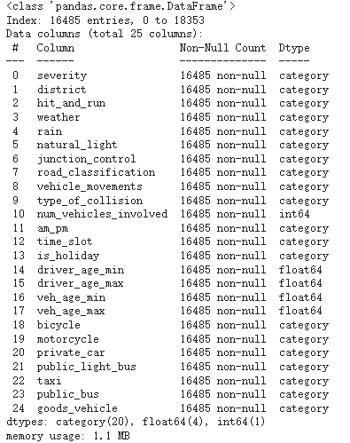
Exploratory Data Analysis
Records: 16485 x 25 columns
Categorical variables: 20
Numerical variables: 5
Target variables: severity
(1 = Serious/ fatal, 0 = Slight)

Slide 7
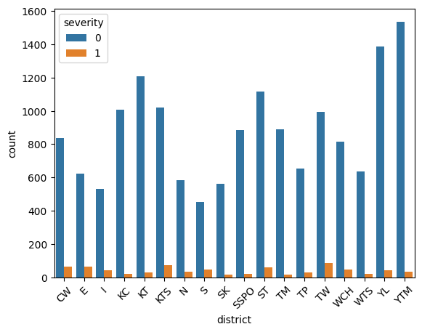
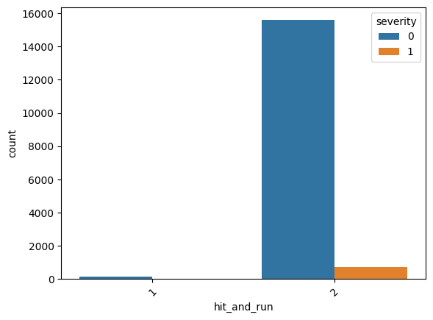
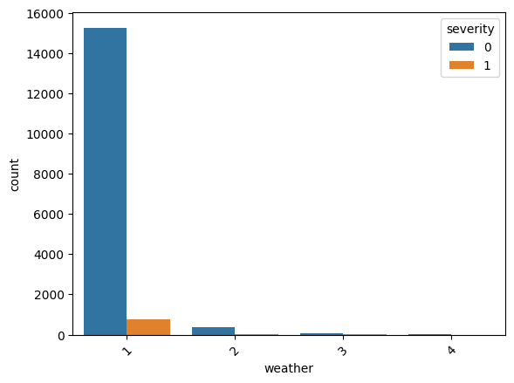
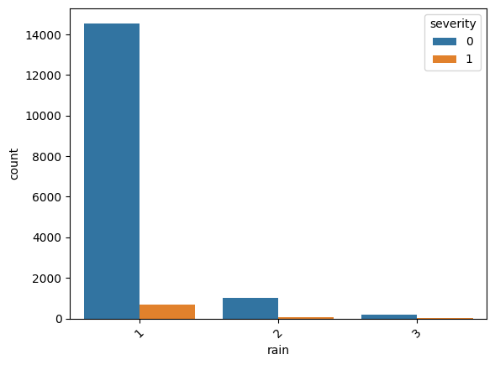
Bivariate Analysis

Slide 8
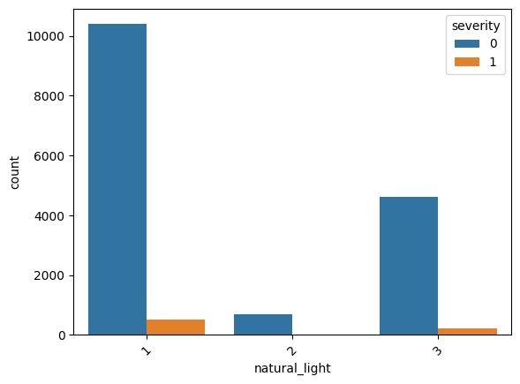
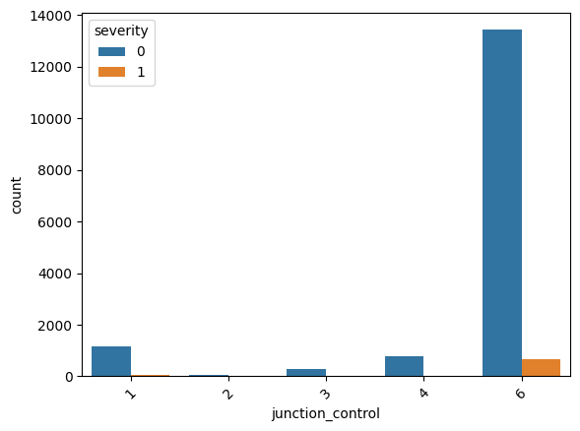

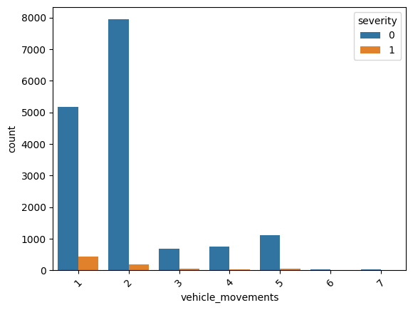
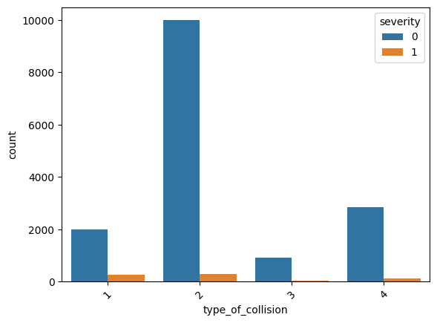
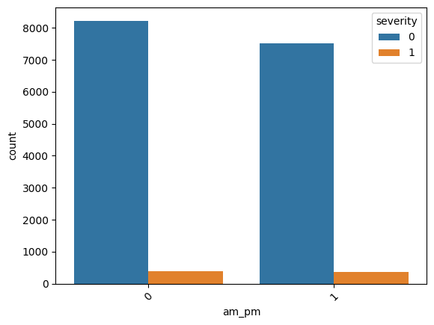
Bivariate Analysis

Slide 9
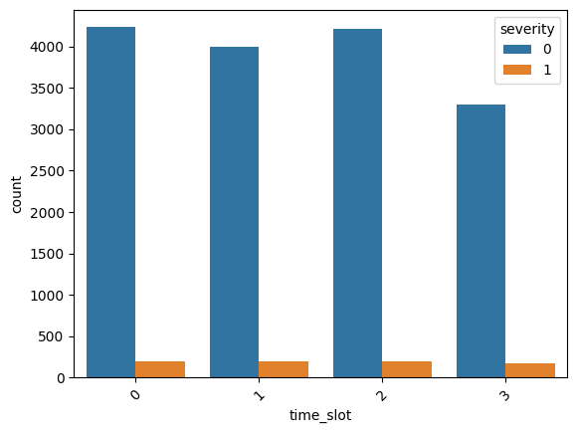
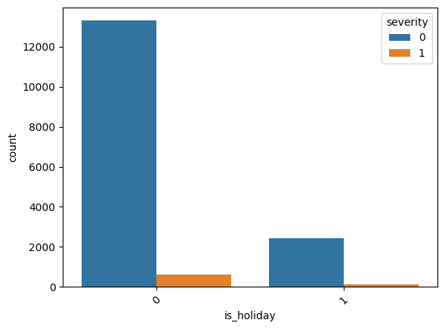
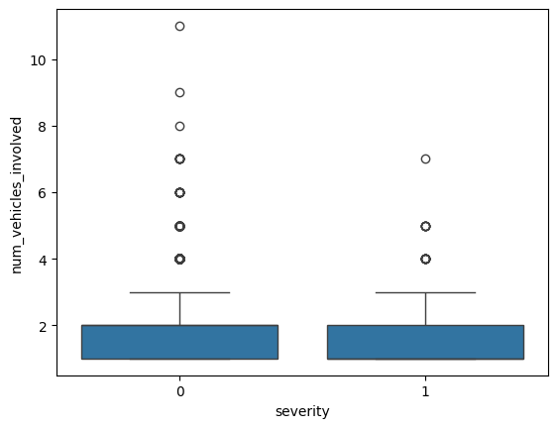
Bivariate Analysis

Slide 10
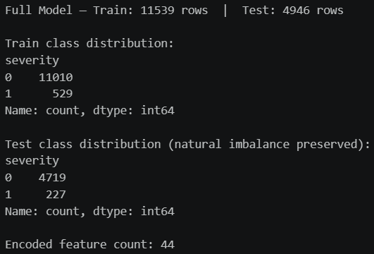
Logistic Regression
70% Training Data
30% Testing Data
Class imbalance exists in the dataset
Building Models

Slide 11
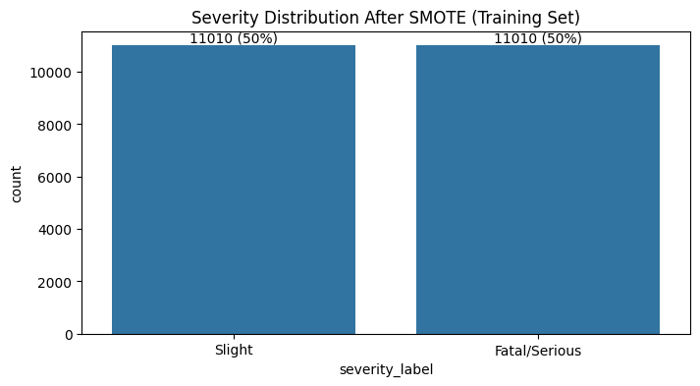
Synthetic Minority Over-sampling Technique (SMOTE)
Generate synthetic minority instances by interploation
Random Oversampling Model
Duplicates existing minority instances at random
Ensemble Model
Downsample the majority class
Handling Class Imbalance

Slide 12
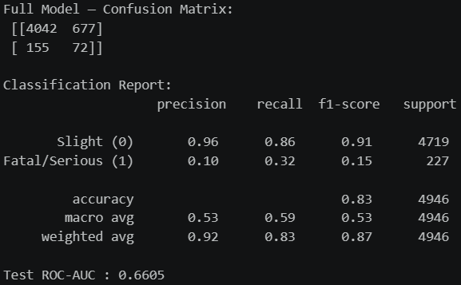
Full Model results
Model Perfprmance (Full Model)

Slide 13
Based on observation from bivariate analysis: remove features with extreme imbalances
Remove features which may cause multicollinearity
Reduces noise: eliminates variables (not contribute signal)
Prevents overfitting: limits the complexity of the model
Simplifies pipeline: focuses resources on high-impact drivers
Variable Selection
Variable | p-value | Status
district | < 0.001 | Retained (Significant, p < 0.05)
type_of_collision | < 0.001
vehicle_movements | < 0.001
road_classification | 1.000 | Dropped (Non-significant or extreme imbalance)
hit_and_run | 0.214
rain | 0.164

Slide 14
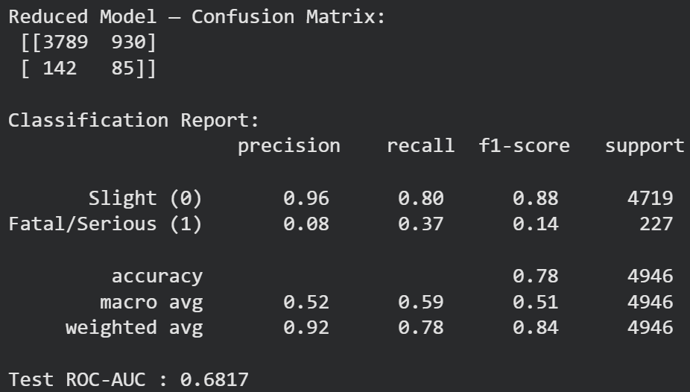
Reduced Model - Cross-validation AUC scores: [0.7066 0.7205 0.6913 0.7278 0.708 ]
Mean CV AUC: 0.7108 ± 0.0125
Model Perfprmance (Reduced Model)

Slide 15
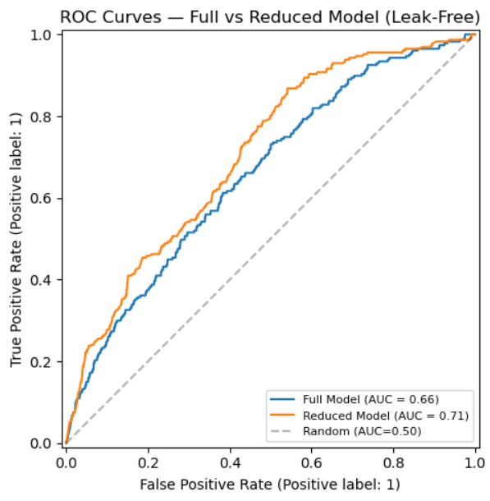
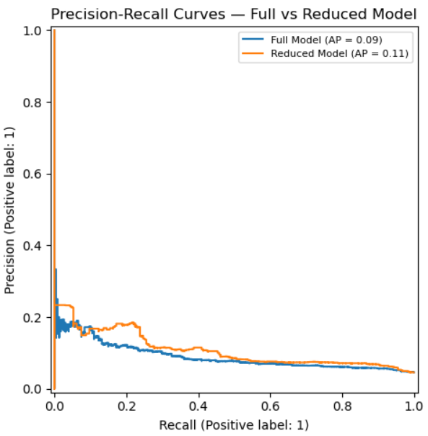
Model Comparison

Slide 16
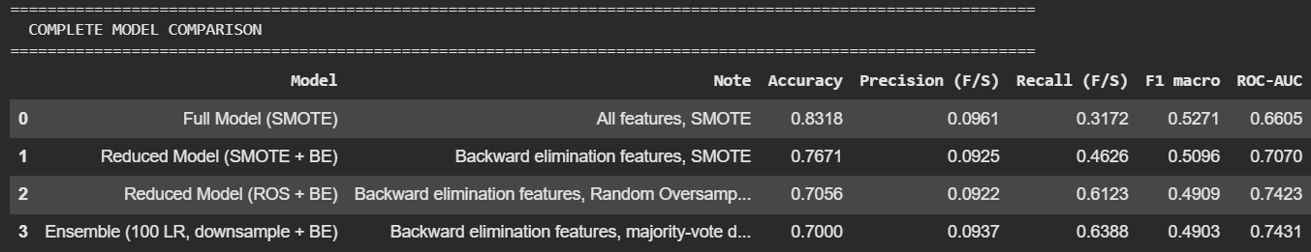
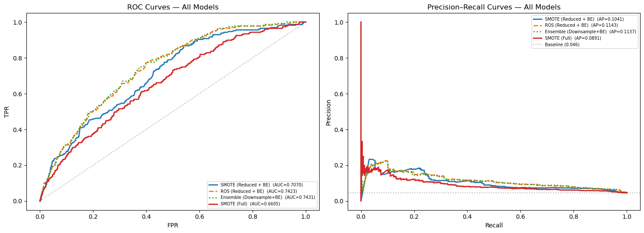
Model Comparison

Slide 17
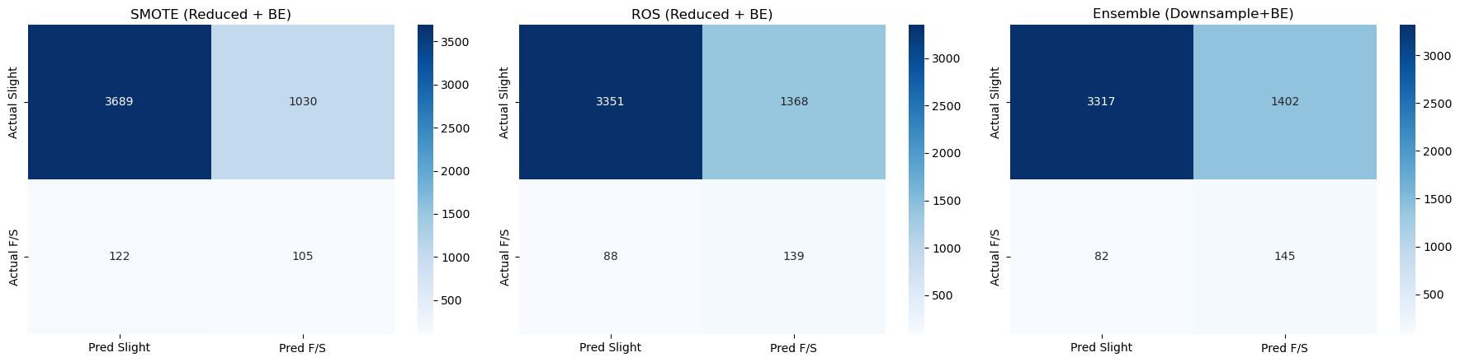
Trade-off summary:
Need high accuracy / fewer false alarms → SMOTE
Need high recall / catch severe accidents → Ensemble (best) or ROS
Need stable high recall with less variance → Ensemble (preferred in production)
Results

Slide 18
Time of Day Matters
Evening/night slots (time_slot_2 [12:00-18:00], time_slot_3 [18:00-24:00]) strongly increase severity risk
District-Level Effects
Certain districts (e.g., Tsuen Wan [TW], Tai Po [TP], Eastern [E], Sha Tin [ST]) show much higher odds of severe accidents
Others (e.g., Yau Tsim Mong [YTM], Kowloon City [KC]) show lower relative risk
Vehicle Type Influence
Motorcycles and bicycles are associated with higher severity odds
Public bus and goods vehicles show negative coefficients, reducing severity likelihood
Traffic Movements
Higher vehicle movements (e.g., vehicle_movements_5: > 2 moving vehicles - from same direction) sharply increase severity
More vehicles involved overall (num_vehicles_involved) reduces severity odds, suggesting multi-vehicle crashes are less severe than single-vehicle/pedestrian collisions
Key Findings

Slide 19
Manage Risky Traffic Movements
Focus on reducing dangerous maneuvers (e.g., risky overtaking, tailgating, sudden lane changes) rather than simply reducing multi-vehicle crashes
Target High-Risk Districts
Localized enforcement and safety campaigns in districts with higher odds of severe accidents (e.g., Tsuen Wan, Kwun Tong, Eastern, Sha Tin)
Infrastructure upgrades tailored to district-specific risk profiles
Address Vehicle-Type Risks
Motorcycle safety campaigns (protective gear, awareness training)
Stricter goods vehicle regulations (speed limits, loading checks)
Taxi and bus driver training programs to mitigate high-severity risks
Prioritize Pedestrian Safety (Collision Types)
Protected crossings and pedestrian zones
Urban speed limits and awareness campaigns to reduce severe pedestrian collisions
Enhance Visibility and Lighting (Time of Day)
Improve street lighting and reflective markings
Special focus on dawn/dusk and nighttime conditions where severity risk spikes
Suggestions

Slide 20

Thank you!
Q & A welcome!

Slide 21
Variable Name | Type | Description
severity | Categorical | 0 = Slight (One or more persons injured and detention in hospital, if required, will not be more than twelve hours.), 1 = Serious (One or more persons injured and detained in hospital for more than twelve hours, or one or more persons died within 30 days of the accident.)
district | Categorical | WCH, KT, SK, TM, KTS, CW, E, YTM, S, I, KC, WTS, TP, SSPO, ST, N, YL, TW
hit_and_run | Categorical | 1 = Yes, 2 = No
weather | Categorical | 1 = Clear, 2 = Dull, 3 = Fog/mist, 4 = Strong wind
rain | Categorical | 1 = Not raining, 2 = Light rain, 3 = Heavy rain
natural_light | Categorical | 1 = Daylight, 2 = Dawn/Dusk, 3 = Dark
junction_control | Categorical | 1 = No control, 2 = Stop (halt), 3 = Give way (slow), 4 = Traffic signal, 5 = Police, 6 = Not junction
vehicle_movements | Categorical | 1 = One moving vehicle, 2 = Two moving vehicles - from same direction, 3 = Two moving vehicles - from opposite direction, 4 = Two moving vehicles - from different, roads, 5 = > 2 moving vehicles - from same direction, 6 = > 2 moving vehicles - from opposite direction, 7 = >2 moving vehicles - from different roads
Variable Summary

Slide 22
type_of_collision | Categorical | 1 = Vehicle collision with Pedestrian, 2 = Vehicle collision with Vehicle, 3 = Vehicle collision with Object (including accidents of unknown accident collision type), 4 = Vehicle without collision
num_vehicles_involved | Numeric | No. of Vehicles Involved
time_slot | Categorical | 0 = 0-6, 1 = 6-12, 2 = 12-18, 3 = 18-24
is_holiday | Categorical | 0 = Not Holiday, 1 = Holiday
has_young_driver | Categorical | 0 = no young driver involved (age < 25), 1 = young driver involved
has_old_driver | Categorical | 0 = no old driver involved (age > 65), 1 = old driver involved
has_old_vehicle | Categorical | 0 = no old vehicles involved (vehicle age > 10), 1 = old vehicles involved
bicycle | Categorical | 0 = accident without bicycle, 1 = accident with bicycle
motorcycle | Categorical | 0 = accident without motorcycle, 1 = accident with motorcycle
private_car | Categorical | 0 = accident without private car, 1 = accident with private car
public_light_bus | Categorical | 0 = accident without public light bus, 1 = accident with public light bus
taxi | Categorical | 0 = accident without taxi, 1 = accident with taxi
public_bus | Categorical | 0 = accident without public bus, 1 = accident with public bus
goods_vehicle | Categorical | 0 = accident without goods_vehicle, 1 = accident with goods_vehicle
Variable Summary

